Slide 1




Embedded Systems Workshop
Session
4

Slide 2




Hello!
Instructor: Mohamed Magdy
Cairo University, Electrical Engineering ( EPE ) Department.
Contact me: mohamed.naem04@eng-st.cu.edu.eg
LinkedIn: https://shorturl.at/hgsIP
@ 2026 Mohamed Magdy

Slide 3

@ 2026 Mohamed Magdy

Slide 4

AGENDA :
Input VS Output
Pull Up VS Pull down
@ 2026 Mohamed Magdy

Slide 5

Input VS Output
@ 2026 Mohamed Magdy
@ 2026 Mohamed Magdy

Slide 6
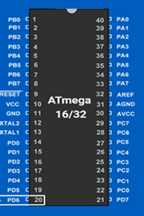
In our course we will use Microcontroller AVR Atmega32.
It has 32 DIO pins grouped as following:
1- PORTA has 8 DIO Pins from A0 to A7
2- PORTB has 8 DIO Pins from B0 to B8
3- PORTC has 8 DIO Pins from C0 to C8
4- PORTD has 8 DIO Pins from D0 to D8
PORT B
PORT A
PORT C
PORT D
@ 2026 Mohamed Magdy
@ 2026 Mohamed Magdy

Slide 7
Each port has 8 pins the pins of these four ports can be used as general purpose input/output (-GPIO-)
PORT B
PORT A
Each I/O Could be input or output (multiplexed direction).This could be controlled through the I/O port direction register
PORT C
PORT D
@ 2026 Mohamed Magdy
@ 2026 Mohamed Magdy

Slide 8
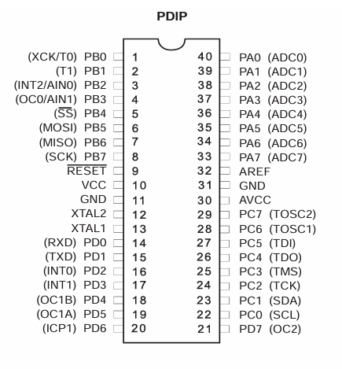
Each MC pin could be assigned to different I/O functions. Pin Could be
configured for digital I/O, analog input, Timer I/O, Serial I/O, For example PD0
could be digital I/O or UART serial input ( Multiplexed Functionality )
@ 2026 Mohamed Magdy
@ 2026 Mohamed Magdy

Slide 9
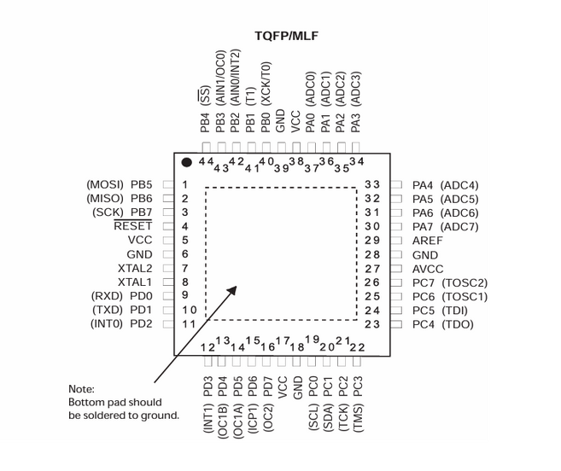
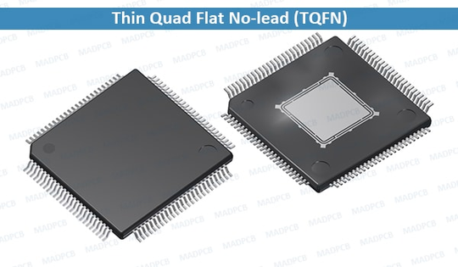
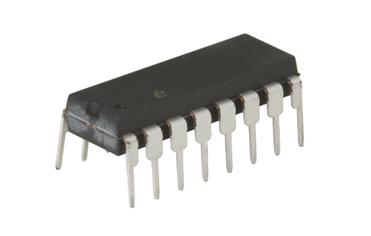
Packaging
PDIP PLASTIC DUAL IN LINE PACAKGE
@ 2026 Mohamed Magdy
@ 2026 Mohamed Magdy

Slide 10


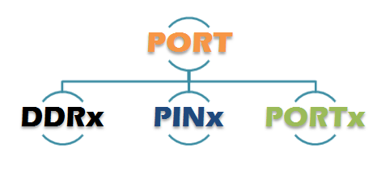
Each Port is controlled by 3 registers
DDRx( Data Direction Register)
This register used to decide the direction of the pins , i.e Whether the pins will act as input pins or as output pins
PORTx( Output Register )
This register is used to set the logic on the output pins HIGH OR LOW
PINx ( Input Register )
This register is used to read the logic level on the port input pins
Note : x could be A,B,C, OR D depending on which port registers are being addressed
@ 2026 Mohamed Magdy

Slide 11
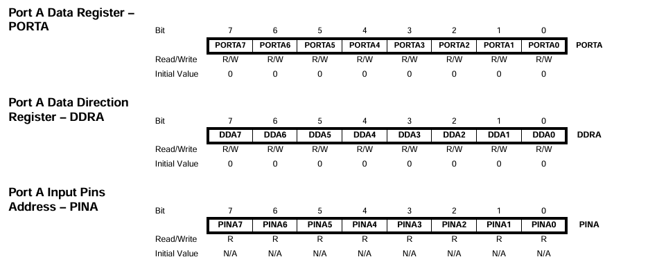
Each Port is controlled by 3 registers
@ 2026 Mohamed Magdy

Slide 12
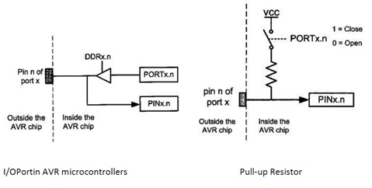
I/O Pin Programming Steps In AVR MC
1-Decide which pin is input and which pin is output
2-Configure the port direction use register DDRx
1 for Output.
0 for Input.
3- In Read (input case) Use register PINx
4-In write ( Output case ) Use register PORTx
@ 2026 Mohamed Magdy

Slide 13
I/O Pin Programming Steps In AVR MC
For each output pin we can perform read/write operation on this pin .We can write on it using PORTx register and read it through PINx or PORTx register .
For each Input pin we can perform read operation only through the PINx register
@ 2026 Mohamed Magdy

Slide 14
Pull Up VS Pull Down
@ 2026 Mohamed Magdy
@ 2026 Mohamed Magdy

Slide 15
Pull Up VS Pull Down
What is Pull-up resistor ?
What is Pull-down resistor ?
Why we need it ?
Why we need it ?
How to use this feature ?
How to use this feature ?
@ 2026 Mohamed Magdy
@ 2026 Mohamed Magdy

Slide 16
Internal Pull Up resistor
In case you set any PIN as input you can activate the internal pull up resistor by setting the corresponding bit in Portx register.
For each Input pin we can perform read operation only through the PINx register.
This feature is supported by all pins in the Atmega16/32 MC.
There is no internal Pull-down resistor in Atmega16/32 MC pins but it could be supported in other MC
@ 2026 Mohamed Magdy

Slide 17
Internal Pull Up resistor
Example :
Setup pin 2 in PORTB as input and activate the internal pull up resistor
DDRB&=~(1<<2);
PORTB|=(1<<2);
@ 2026 Mohamed Magdy

Slide 18
Internal Pull Up resistor
Lets Summarize our cases :
A PORT can have four different states depending upon the state of the bits corresponding to this pin in the data direction register (DDRx) and a data register (PORTx) of that specific port.
@ 2026 Mohamed Magdy

Slide 19
4 Cases
DDxn
PORTxn
I/O
PULL-UP
Comment
O
NO
TRI-STATE
( HIGH-Z )
0
I
Pxn will source current if pulled low externally
0
1
I
YES
output
low ( sink )
1
0
O
NO
output
high ( source )
1
1
O
NO
@ 2026 Mohamed Magdy
@ 2026 Mohamed Magdy

Slide 20

Internal Pull Up resistor
This is internal PULL-UP resistor to all the pins can be disabled by writing one to the PUD BIT IN THE SFIOR register When this is done the pins are in tri state( high impedance states ) if DDRxn =0 and PORTXN=1
Bit-2 ( PUD ) : Pull up disable
when this bit is written to one , the pull-ups in the I/O ports are disabled even if the DDxn and PORTxn Registers are configured to enable the PUll-ups
@ 2026 Mohamed Magdy

Slide 21

Basics
@ 2026 Mohamed Magdy
@ 2026 Mohamed Magdy

Slide 22
How to set values in registers ?
Set all pins of Port A AS OUTPUT
DDRA = 255;
DDRA= 0xFF;
DDRA=0b11111111;
@ 2026 Mohamed Magdy

Slide 23
How to set values in registers ?
set all Pins in PORTA
PORTA=255;
PORTA= 0xFF;
PORTA=0b11111111;
@ 2026 Mohamed Magdy

Slide 24
How to set values in registers ?
Clear all pins in PORTA
PORTA=0;
PORTA= 0x00;
PORTA=0b00000000;
@ 2026 Mohamed Magdy

Slide 25

How to deal with a specific pin and conserving other pins ?
Set Specified bit in register
Make OR operation on the old register value with one shift left by the pin number For example if we want to set pin number 5 in PORTA
PORTA|= (1<<5);
Clear( reset ) specified bit in register
Make AND operation on the old register value with the 1 ‘s complement value of one shift left bt the pin number For example if we want to clear pin number 3 in PORTB
PORTB&=~ (1<<3);
@ 2026 Mohamed Magdy
@ 2026 Mohamed Magdy

Slide 26
How to deal with a specific pin and conserving other pins ?
Toggle or Flip specified bit in register
Make XOR operation on the register old value with one shift left by the pin number for example if we want to toggle pin number 2 in PORTC
PORTC^=(1<<2);
@ 2026 Mohamed Magdy
@ 2026 Mohamed Magdy

Slide 27
How to deal with a specific pin and conserving other pins ?
Check if a specified bit is set ( one )
Make AND operation on the register value with one shift left by the pin number For examlpe check if pin 2 in PORTD Is set
if( PIND&(1<<2) ) {
/*CODE*/
}
@ 2026 Mohamed Magdy
@ 2026 Mohamed Magdy

Slide 28
How to deal with a specific pin and conserving other pins ?
Check if a specified bit is cleared ( reset or zero )
Just revert the previous condition For example check if pin 2 IN PORTD is cleared
if( ! ( PIND &(1<<2) ) ) {
/*CODE*/
}
@ 2026 Mohamed Magdy
@ 2026 Mohamed Magdy

Slide 29
Know More about your MC
( DATA SHEET )
Sink current vs Source current
Sink current :
PIN LOW
the sink value is the amount of current that can flow into the pin ( and therefore into the MC) safely.
Source current :
PIN HIGH
The SOURCE current is the amount of the current that can be pulled out of the pin safely.
It is very important that you try to limit the amount of current flowing into and out of your pin ( typically using series resistance )
@ 2026 Mohamed Magdy
@ 2026 Mohamed Magdy

Slide 30

Applications
@ 2026 Mohamed Magdy
@ 2026 Mohamed Magdy

Slide 31
Output pins
Input pins
LED AND 7-Segemnt
Switches ( Push button ,keypad and etc.. )
LCD display
analog/digital sensors
Motors
Signal from another MC
Buzzer
input from PC through PC Serial Port
Signal to other MC
Output to PC through PC Serial Port
@ 2026 Mohamed Magdy

Slide 32
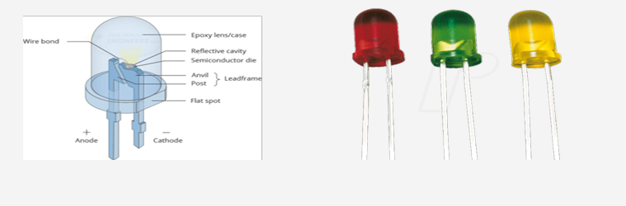
Interfacing
LED :
Light Emitting Diode is an electrical element that emits light
by supplying a voltage difference between its terminals
@ 2026 Mohamed Magdy

Slide 33

Interfacing
LED :
Negative Logic
Positive Logic
R= 220 : 350
@ 2026 Mohamed Magdy

Slide 34
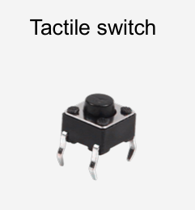
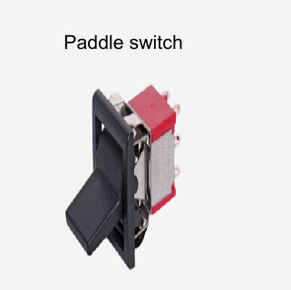
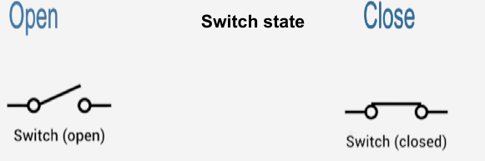
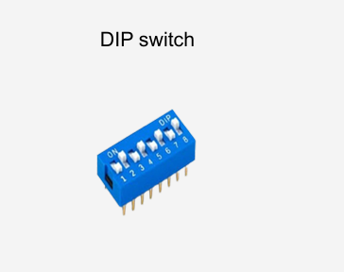
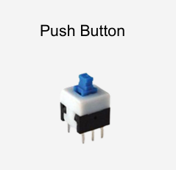
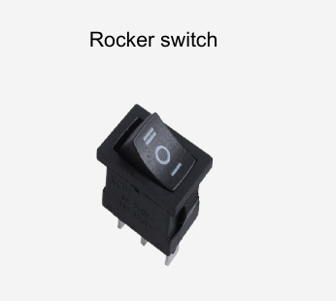
Interfacing
Mechanical Switch :
Mechanical Switch is an electrical component that can connect or break an electrical circuit.
@ 2026 Mohamed Magdy

Slide 35
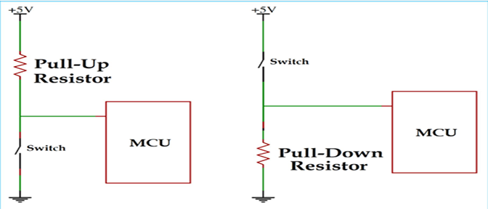
Interfacing
Mechanical Switch :
Switch shall be connected by pull up or pull down resistor to avoid short circuits.
@ 2026 Mohamed Magdy

Slide 36
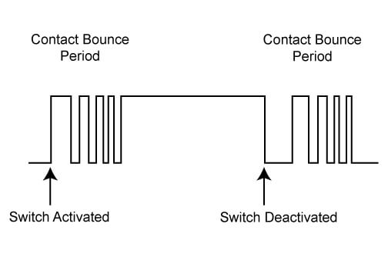
Interfacing
De-bonce Issue
When the Push Button is pressed the switch does not provide a clean edge The input value is bouncing for 10-30 ms
If this signal was used as an input to a digital counter for example you would get multiple counts rather than the expected single count
Sol:
1-Software
2-hardawre
@ 2026 Mohamed Magdy

Slide 37
infinite Loop
Any C project in Embedded Systems application shall have an infinite loop called Super loop . This loop is a must even if you will leave it empty!!
Super loop used as here we have an embedded application used for a certain purpose
This loop prevents the program counter ( PC ) from continues incrementing over the flash memory and execute a garbage code.
while(1) {
/*code*/
}
for(;;){
/*code*/
}
loop:
/*code*/
gotoloop;
Most Common
Better performance
Not Good !
@ 2026 Mohamed Magdy

Slide 38
Busy loop Delay
Software Technique to make the processor halt it’s activity for a certain time using loop.
Delay Library “util/delay.h” In AVR provides Two basic functions:
_delay_ms (value in ms);
_delay_us (value in us);
Before Using the delay library we have to define our system frequency through the F_CPU macro used by the delay library:
#define F_CPU 8000000UL 8MHZ
If not defined it will use its default frequency value which is 1Mhz
@ 2026 Mohamed Magdy

Slide 39

In Assignment
• Build: Button → LED system Using layered architecture
@ 2026 Mohamed Magdy
@ 2026 Mohamed Magdy

Slide 40
TASK
• Build: Traffic Light system
@ 2026 Mohamed Magdy
@ 2026 Mohamed Magdy

